Slide 1
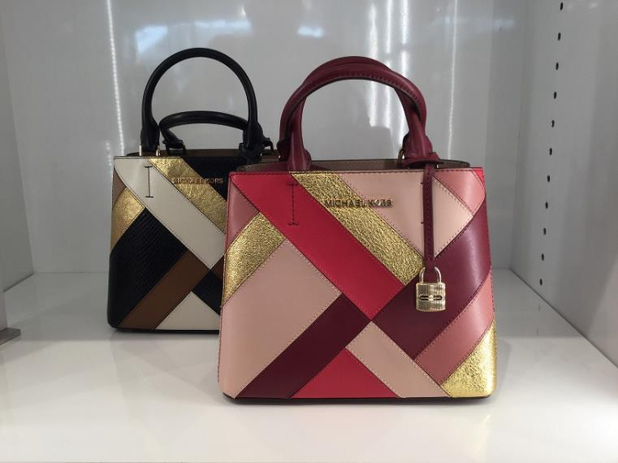
ADELE MD MESSANGER
Retail 375
Black Mlt – 19
Malberry Mlt – 11
231774426
231774422

Slide 2
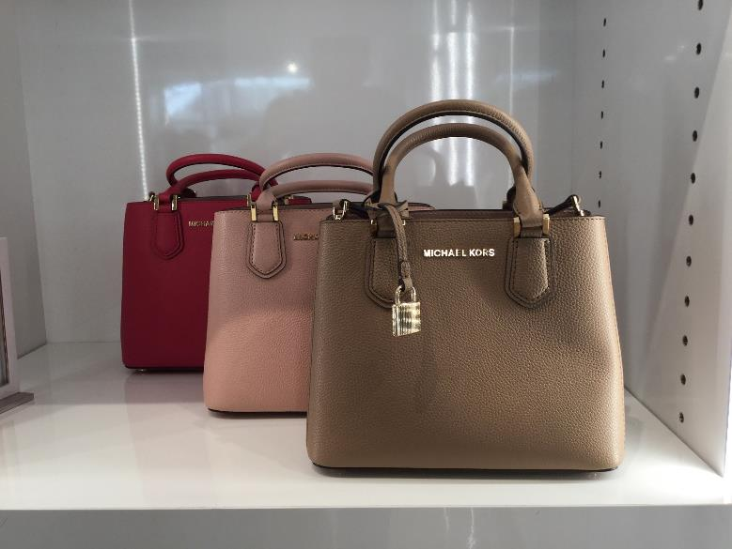
ADELE MD MESSANGER
Retail 350
Dk Khaky – 29
RubinRed – 29
Pastel Pink – 2
231779787
231779784
231712691

Slide 3
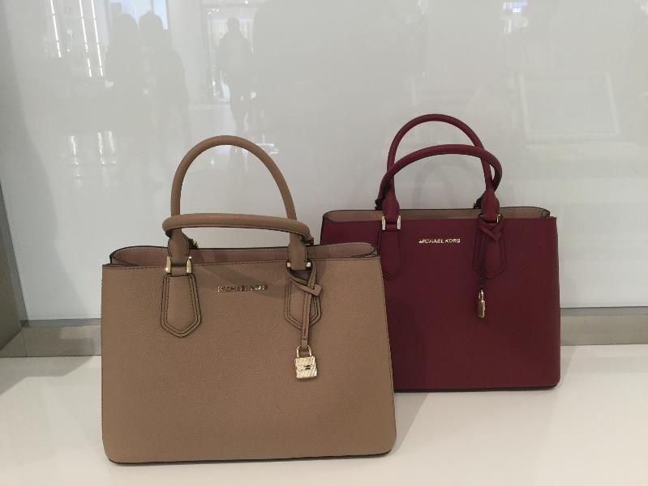
ADELE MD EW SATCHEL
Retail 425
Dk Khaky – 33
Mulberry – 0
231774444
231774440

Slide 4
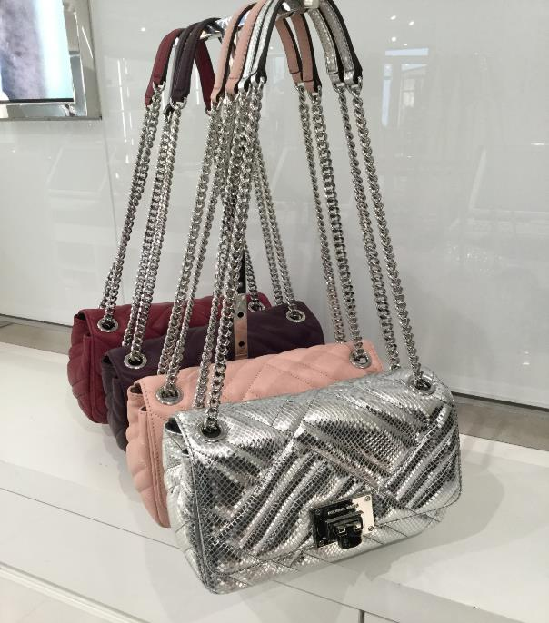
VIVIANNE MEDIUM SHLDR FLAP
Retail 360
Ash grey 231778680 – 18
Pastel Pink 231778683 – 21
Silver 231778686 – 5

Slide 5
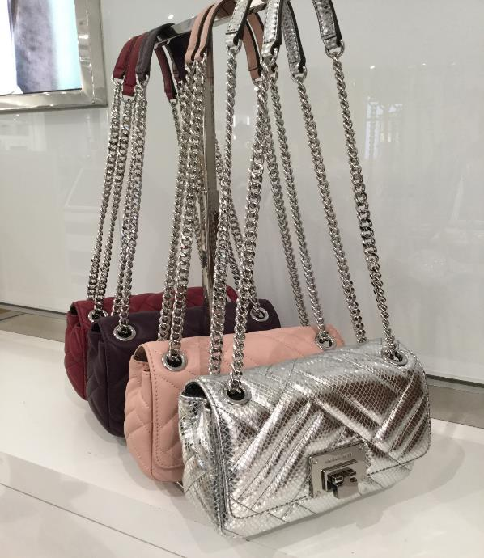
VIVIANNE SMALL SHLDR FLAP
Retail 350
Pastel Pink 231778691 – 28
Damson 231778690 – 1
Silver 231778694 – 32
Black 231778687 – 7

Slide 6
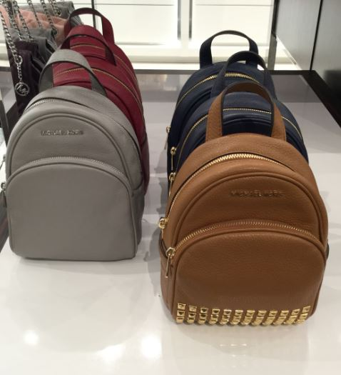
ABBEY SM BACKPACK
Retail 300
Mulberry 231779647 – 3
Navy stud 126201916 – 8
Black 126201889 – 29
Navy 126201894 – 22

Slide 7
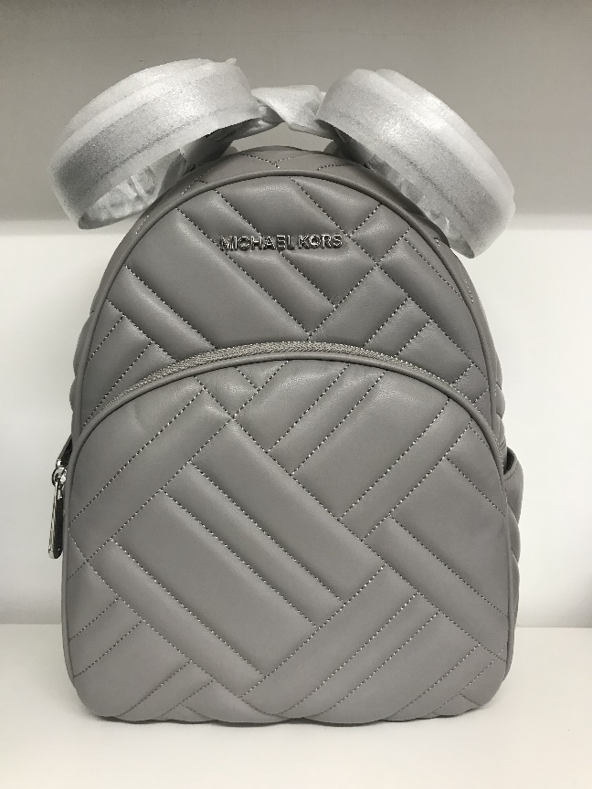
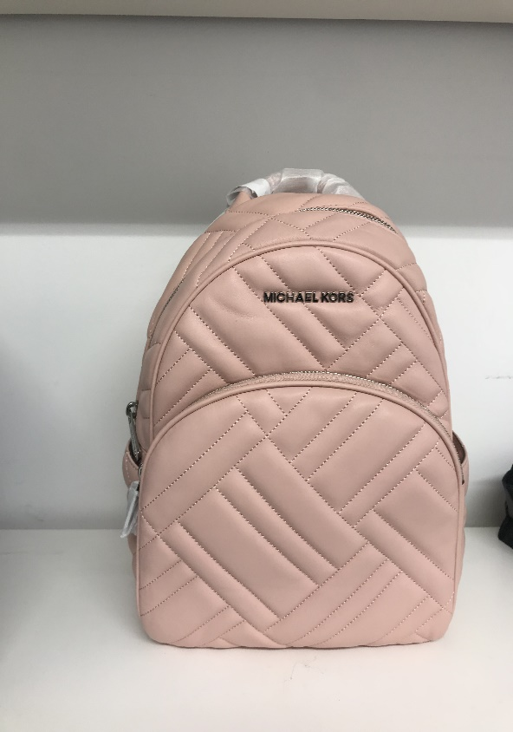
ABBEY LG BACKPACK
Retail 425
Pastel Pink 231777192 – 50
Ash Grey 231777186– 30

Slide 8
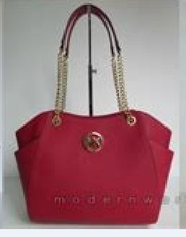
JET SET TRAVEL CHAIN
Retail 375
Mulberry 231775946 – 43

Slide 9
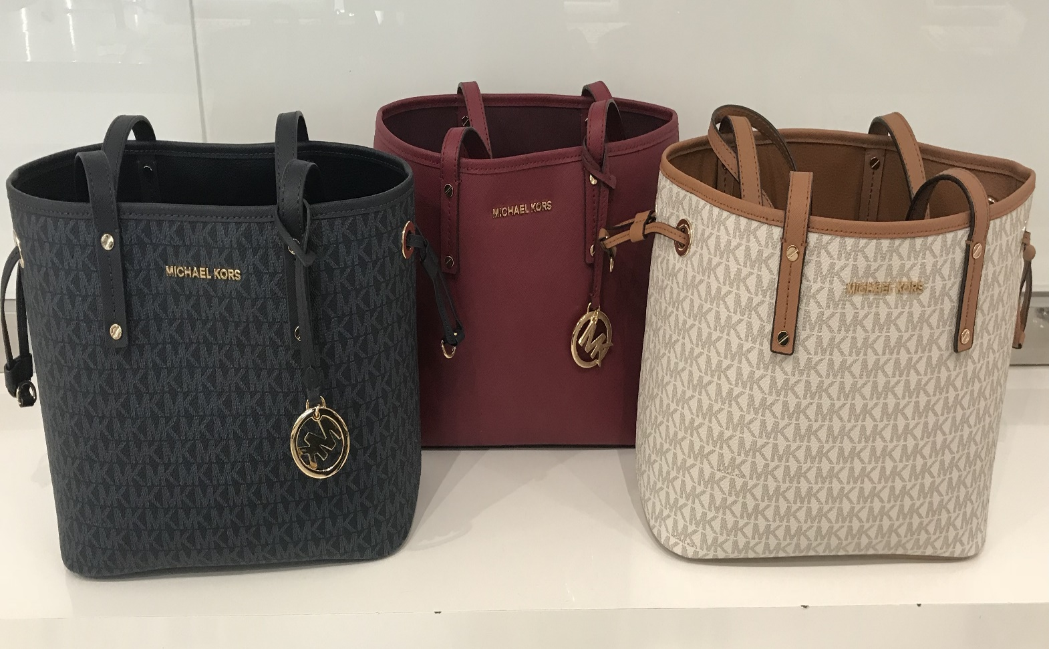
Jet set travel Reversible
Retail 300
Mulberry 231776142 – 11
Admiral 231776148 – 29
Vanilla 231776147 – 26

Slide 10
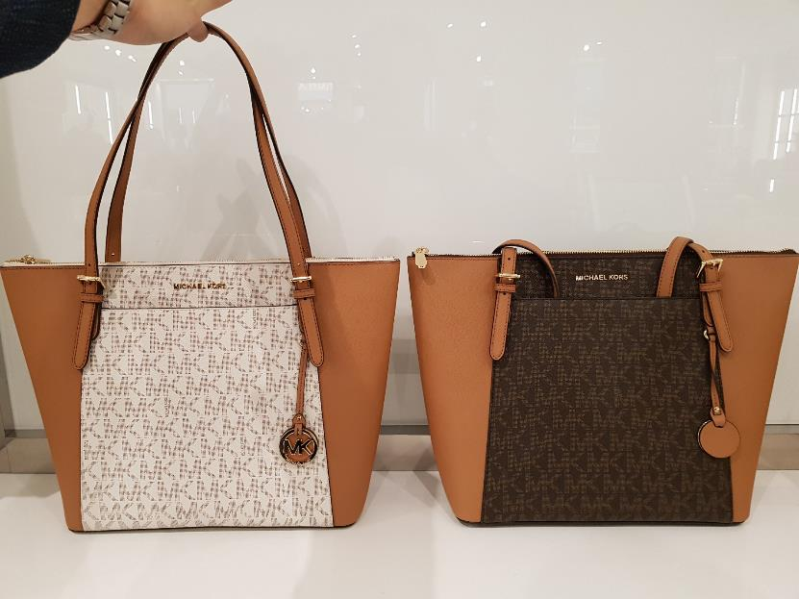
CIARA TOTE
Retail 375
Vanilla – 55
Brown – 22
231712905
231712916

Slide 11
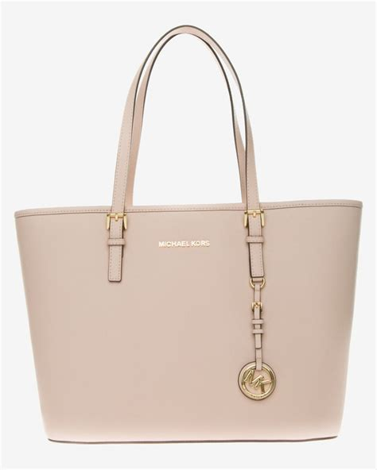
SADY LG Tote
Retail 375
Navy (siler) 126203359 – 20
Vanilla acorn 231774589 – 28
Luggage 126202178 – 33
Pastel Pink 231779670 – 24
Fawn 231779664 – 22
Navy (gold) 126202181 – 42
Emerald 231779665 – 10
Brown acorn 231789049 – 4

Slide 12
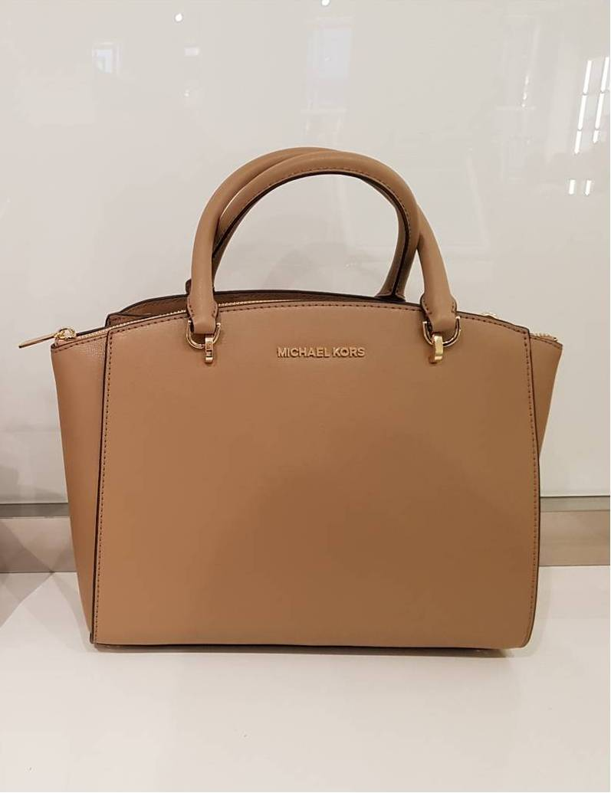
Borsa Ellis Satchel Large
Retail 450
Brown - 46
juju

Slide 13
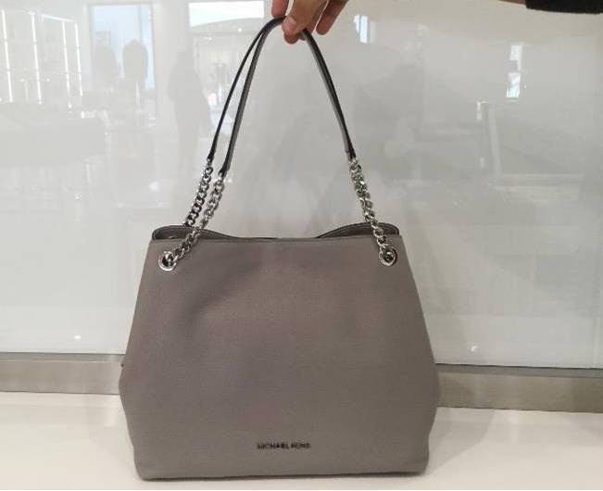
Jet Set Item Chain
Retail 425
Pearl Grey - 35

